Slide 1
Exploratory Analyses of Crash Data
Fall 2023

Slide 2
How to “map” crashes on network
In the previous lecture, I showed how to link different databases together.
Usually, we link them via the location (control-section or GIS) and then match the crashes to the characteristics of the location.
Not only do we need to match the crashes, but we also need to use the total sampling frame, even those that do not include crashes.
Even the sites or observations that have 0 crash provides information.

Slide 3
Sampling Frame
Sampling frame: the sampling frame is the list of the population (this is a general term) from which the sample is drawn. It is important to understand how the sampling frame defines the population represented.
Example: Texas Ave is separated into 8 segments (next few slides). Crashes have been reported for two years. For this exercise, we are grouping section and intersection crashes together. Usually, we separate intersections from those that occurred on segments/sections. See Highway Safety Manual.

Slide 4
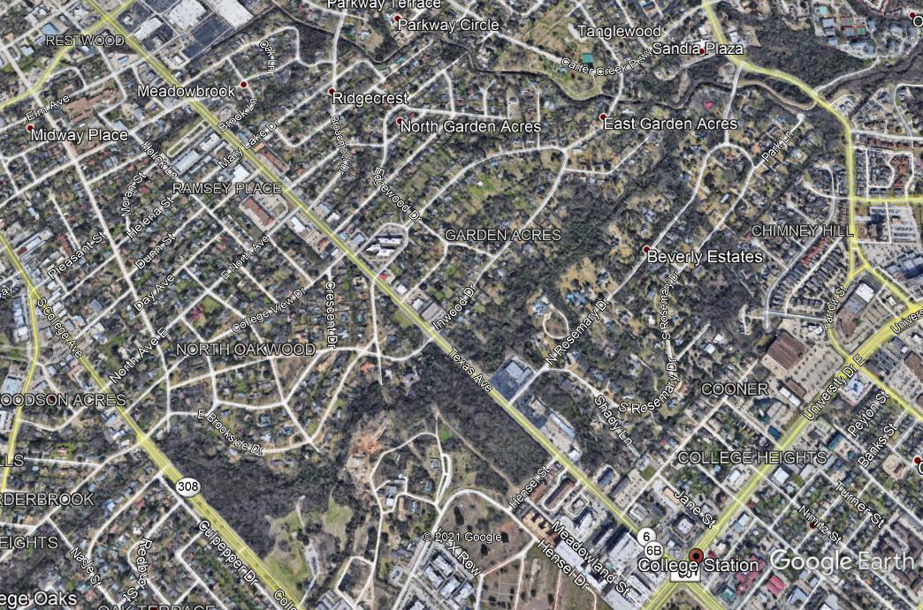
Sampling Frame
Network

Slide 5
Sampling Frame
Sampling Frame

Slide 6
Mapping Crashes
Mapping Crashes Year 1

Slide 7
Mapping Crashes
Mapping Crashes Year 2

Slide 8
Assembling Database
Database separated by year
Variables: AADT, segment length, lane width, shoulder width, etc.

Slide 9
Assembling Database
Aggregated Data
Variables: AADT, lane width, shoulder width, etc. But they need to stay the same for the time period. Not all variables stay the same, such as AADT. For that variable, you need to take the average for the aggregated time period. For some, if they change during the period, the site will need to be removed.

Slide 10
Objectives
Exploratory data analyses are used to accomplish the following objectives:
1. Understanding the data, mapping their underlying structure and identifying data issues such as errors and missing information,
2. Selecting the most important variables and identifying possible relationships in terms of direction and magnitude between independent and outcome variables,
3. Detecting outliers whose values are significantly different from the other observations in the dataset,
4. Testing hypotheses and developing associated confidence intervals or margins of error,
5. Examining underlying assumptions to know if the data follows a specific distribution, and
6. Choosing a preliminary model that fits the data appropriately.
Note: check Chapter 5 for all the important equations.

Slide 11
Quantitative Techniques
Measures of central tendency
  Mean, Median, Mode
Measures of variability
  Range, Quartiles and interquartile range, Variance, standard deviation and standard error, Coefficient of variation
  Symmetrical and asymmetrical data, Skewness, Kurtosis (measure of the sharpness of the peak of a frequency distribution; see next slide).

Slide 13
Quantitative Techniques
Measures of association
  Pearson’s correlation coefficient, Spearman rank-order correlation coefficient, Chi-square test for independence (next slide), Relative risk and odds ratio (below)

Slide 16
Confidence Intervals
Statistics are usually calculated from samples, such as the sample average X, variance s², the standard deviation s, are used to estimate the population parameters. For instance:
X is used as an estimate of the population μ_{x}
s² is used as an estimate of the population variance σ²
Interval estimates, defined as Confidence Intervals, allow inferences to be drawn about the population by providing an interval, a lower and upper value, within which the unknown parameter will lie with a prescribed level of confidence. In other words, the true value of the population is assumed to be located within the estimated interval.

Slide 17
Confidence Intervals
Confidence intervals for unknown mean and known standard deviation
Confidence intervals for unknown mean and unknown standard deviation
Confidence intervals for proportions

Slide 18
Confidence Intervals
Confidence intervals for the population variance and standard deviation

Slide 19
Confidence Intervals

Slide 20
Hypothesis Testing
Test to determine whether a hypothesis is true or not based on sample data.
Step 1 – State the hypothesis
H₀ (null hypothesis): no variation exists between the variables or that a single variable is different than its mean.
H₁ (alternative hypothesis): variation exists between the variables or that a single variable is different than its mean.
Both hypotheses are mutually exclusive.
Step 2 – Select confidence interval
This step involves selecting the appropriate confidence interval (C). The significance level could be equal to 0.01, 0.05 or 0.10.

Slide 21
Hypothesis Testing
Step 3 – Choose the test method and compute probability
The test method is highly dependent on the data sampling distribution. The test
method typically involves a test statistic that might be a mean score, proportion, difference between means, difference between proportions, etc. Compute the probability (P-value) that provides an evidence whether to accept or reject the null hypothesis.
Step 4 – Interpret results
The P-value is compared against the significance level (1-C) selected in Step 2. If the P-value is less than 1-C, then there is an evidence to reject the null hypothesis which states that the observed effect is statistically significant, and the alternative hypothesis is considered valid. Alternatively, if P-value is greater than the significance level, the null hypothesis cannot be rejected, which states that the observed effect is not statistically significant. As the P-value becomes smaller, the evidence against the null hypothesis becomes stronger.

Slide 22
Hypothesis Testing

Slide 23
Hypothesis Testing
Decision Errors
• Type I error. A Type I error occurs when a null hypothesis is rejected even though it is true. The probability of committing a Type I error is nothing but the significance level a selected in Step 2 of a hypothesis test.
• Type II error. A Type II error occurs when a null hypothesis is not rejected even though it is false. The probability of committing a Type II error is denoted by b. The probability of not committing a Type II error is called the Power of the test, and is denoted by 1- b.
Two-tailed hypothesis test
The two-tailed test is a method in which the rejection region is on two
sides of the sampling distribution.
One-tailed hypothesis test
A one-tailed test is a statistical test in which the rejection region is onesided
of the sampling distribution.

Slide 24
Hypothesis Testing
Hypothesis testing for one sample
When the population mean and standard deviation are known, the z statistic is calculated as
When the population mean is known and the standard deviation is unknown, the test statistic is calculated as
You compare the value with the one documented in the table on the next slide.

Slide 25
Hypothesis Testing
Hypothesis testing for one sample
See Chapter 5 in textbook for the proportion and variance calculations.

Slide 26
Hypothesis Testing
Hypothesis testing for two samples
Comparing two samples is of great interest to understand the difference between the two groups. The groups can be either dependent or independent with each other.
In dependent groups, the observations from one group are paired with observations in the other group, so it is called matched pairs.
When independent groups are considered, observations selected from one group are completely independent from the observations selected in the second group.

Slide 27
Hypothesis Testing
Hypothesis testing for two samples
Dependent Samples
The paired sample t-test is the most common statistical procedure used for dependent samples. This test is useful for evaluating the differences in two time periods for the same observation or for comparing the two different treatments applied at the same site in different times.
The difference is then tested using the same equation described above with μ=0:

Slide 28
Hypothesis Testing
Hypothesis testing for two samples
Independent Samples
The parameters tested using independent samples are either population means or population proportions. For this kind of analysis, the sample size (n) and the standard deviation (s) will be different for each population. The testing will be dependent on the sample size for both populations. When it is large, the normal distribution can be used and when they are small (~5 to 25), the student-t distribution needs to be used.
See section 5.2.5.5 in Chapter 5 for more details.
Multiple Independent Samples: Use ANOVA (also described in Chapter 5)

Slide 29
Summary Statistics

Slide 30
Graphical Methods
Box Plot and Whiskers

Slide 31
Graphical Methods
Bar Graphs

Slide 32
Graphical Methods
Box Plot

Slide 33
Graphical Methods
Histograms

Slide 34
Graphical Methods
Histograms

Slide 35
Graphical Methods
Bar Graphs

Slide 36
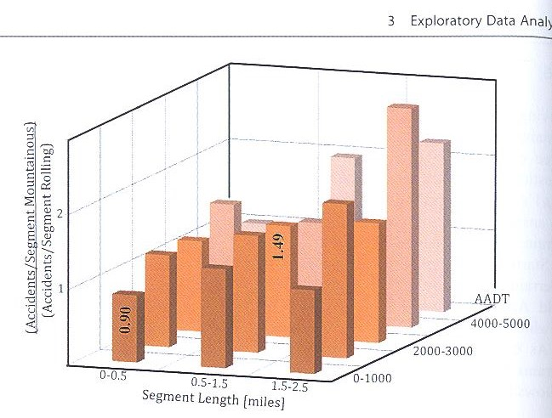
Graphical Methods
3D Histograms

Slide 37
Graphical Methods
Histogram with Proportions

Slide 38
Graphical Methods
Mosaic Plot

Slide 39
Graphical Methods
Error plots

Slide 40
Graphical Methods
Pie charts

Slide 41
Graphical Methods
Scatter Plots

Slide 42
Graphical Methods
Scatter Plots

Slide 43
Graphical Methods

Slide 44
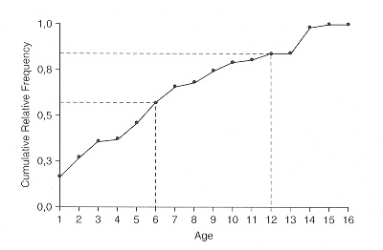
Graphical Methods
Ogives. Source: Washington et al. (2003)

Slide 45
Graphical Methods
Bubble Chart

Slide 46
Graphical Methods
Radar Plots

Slide 47
Graphical Methods
Heat Map

Slide 48
Graphical Methods
Maps

Slide 49
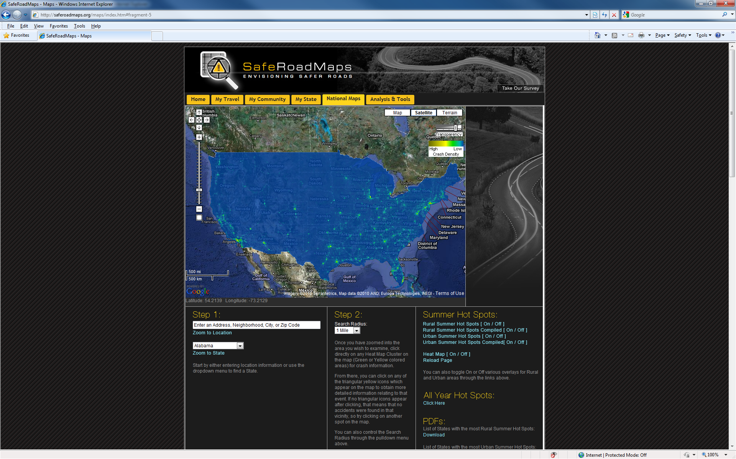
Maps – GIS Information
http://www.saferoadmaps.org/home/

Slide 50
Graphical Methods
Contour Lines

Slide 51
Graphical Methods
Pyramid

