Slide 1
Data Collection & Crash Data Management
Fall 2023

Slide 2
Sources of Data
Traditional Data
Crash Data (Police reports, self-reporting, etc.)
Traffic Conflicts/Surrogate Measures of Safety
Hospital
Crash Reconstruction
Insurance (Private)
Naturalistic Data
Instrumented Vehicles
Vehicle Blackboxes
Safety Systems (Onstar, etc.)
Social Media/Crowd Sourcing Data
Twitter, Facebook, Instagram, Waze
Disruptive Technological Data (enhance or new technology)
Cellphones
Video Recording/Processing
Roadside Sensors (Toll Roads, etc.)
Links are provided at the end.

Slide 3
Traditional Data
General Characteristics
Despite the flaws, crash data provide the ultimate sources of information about the safety performance of roadway elements.
Unfortunately, people get hurt or killed and properties get damaged before finding this performance.
Highly dependent on severity of the crash
Crash data used for:
Identification of hazardous sites
Benefit-costs analysis
Safety relationships (statistical models)
Highway design process
Policy development
Links are provided at the end.

Slide 4
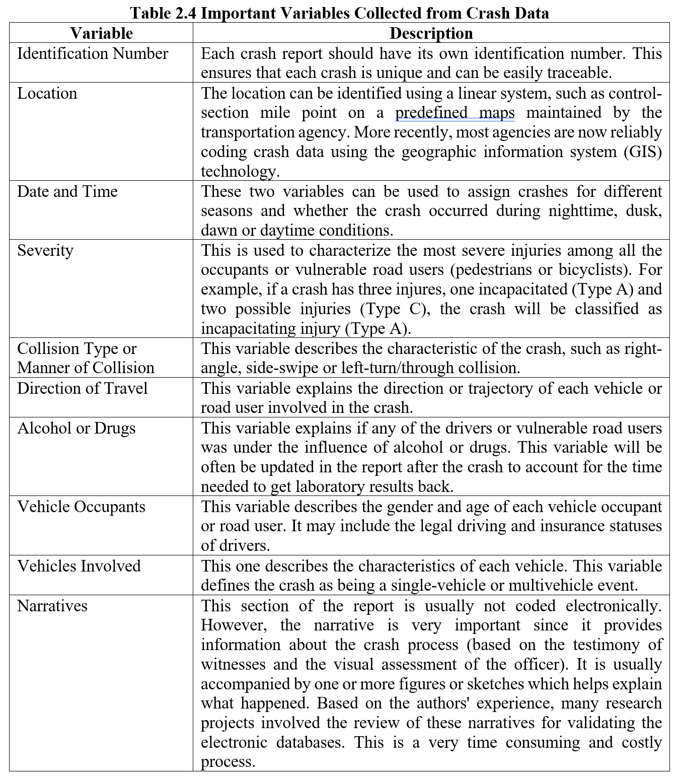

Slide 6
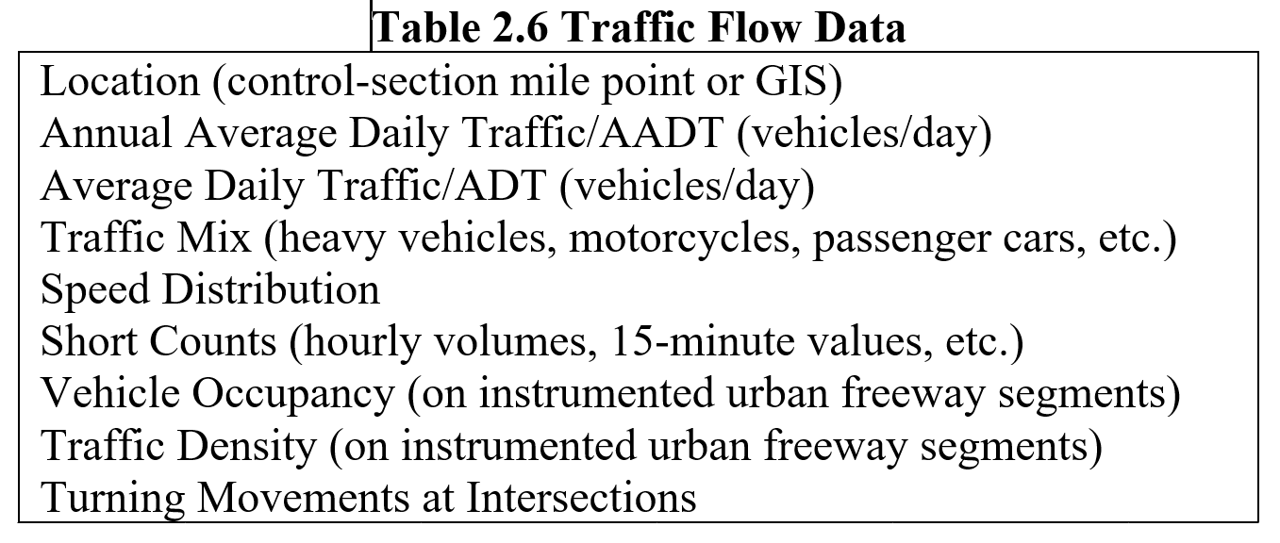

Slide 7
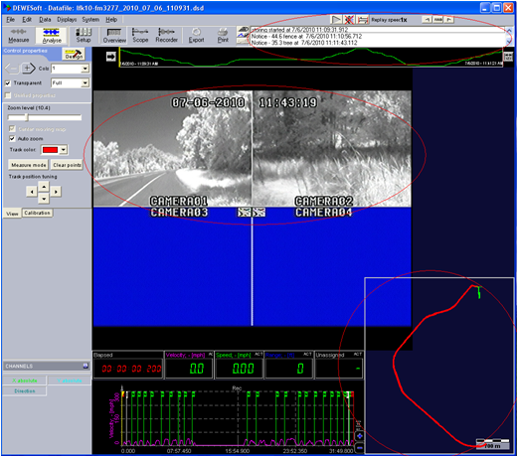
Video Logs

Slide 8
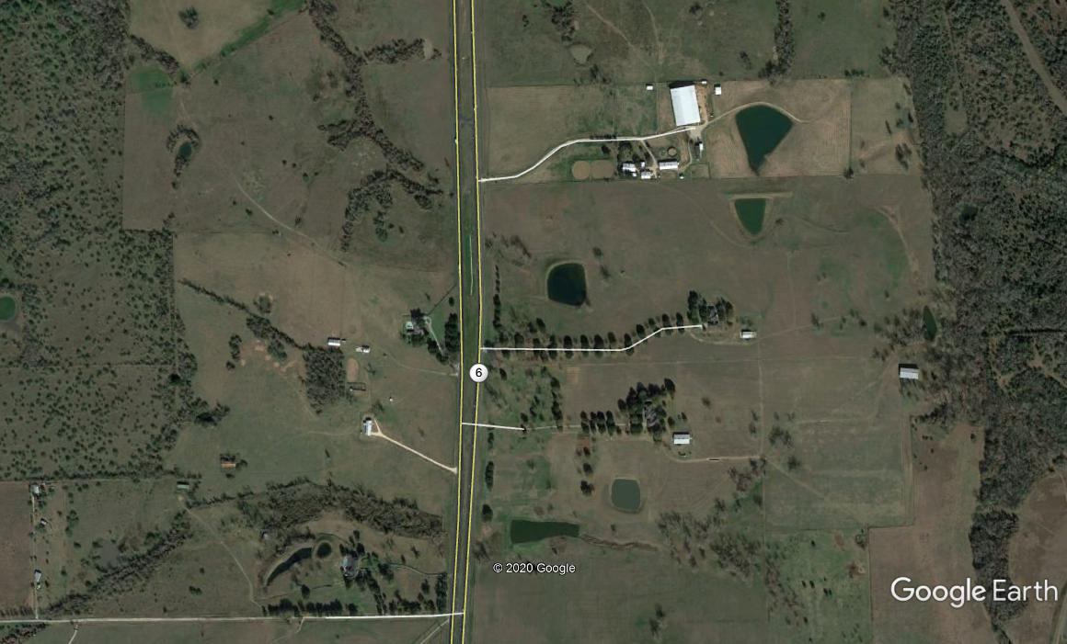
Google Earth

Slide 9
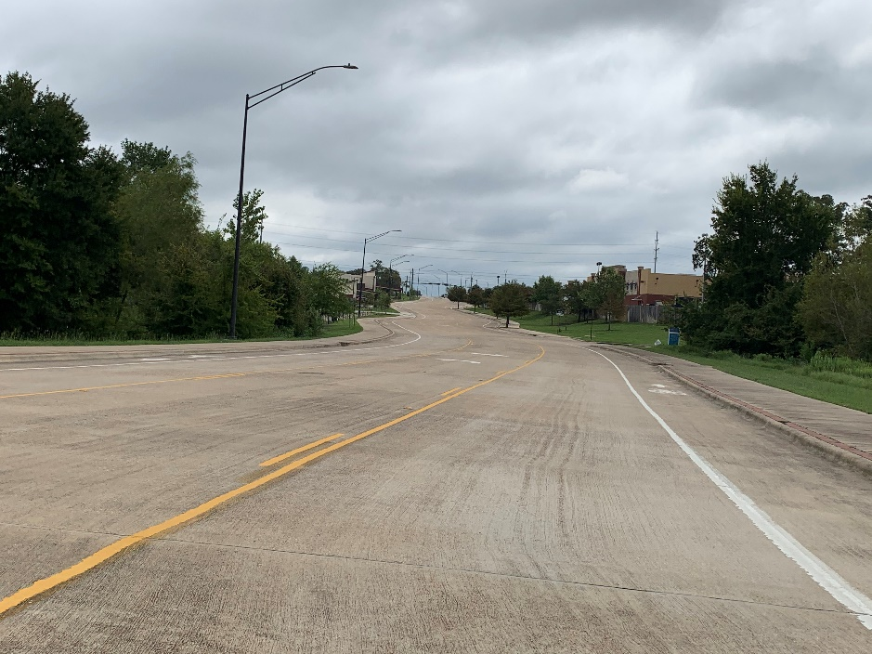
StreetView

Slide 10
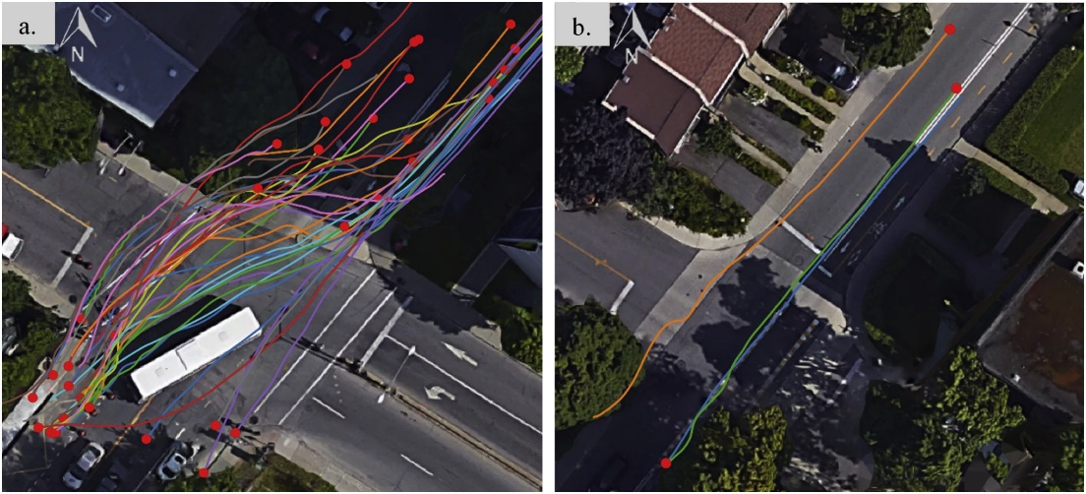
Video Processing

Slide 11
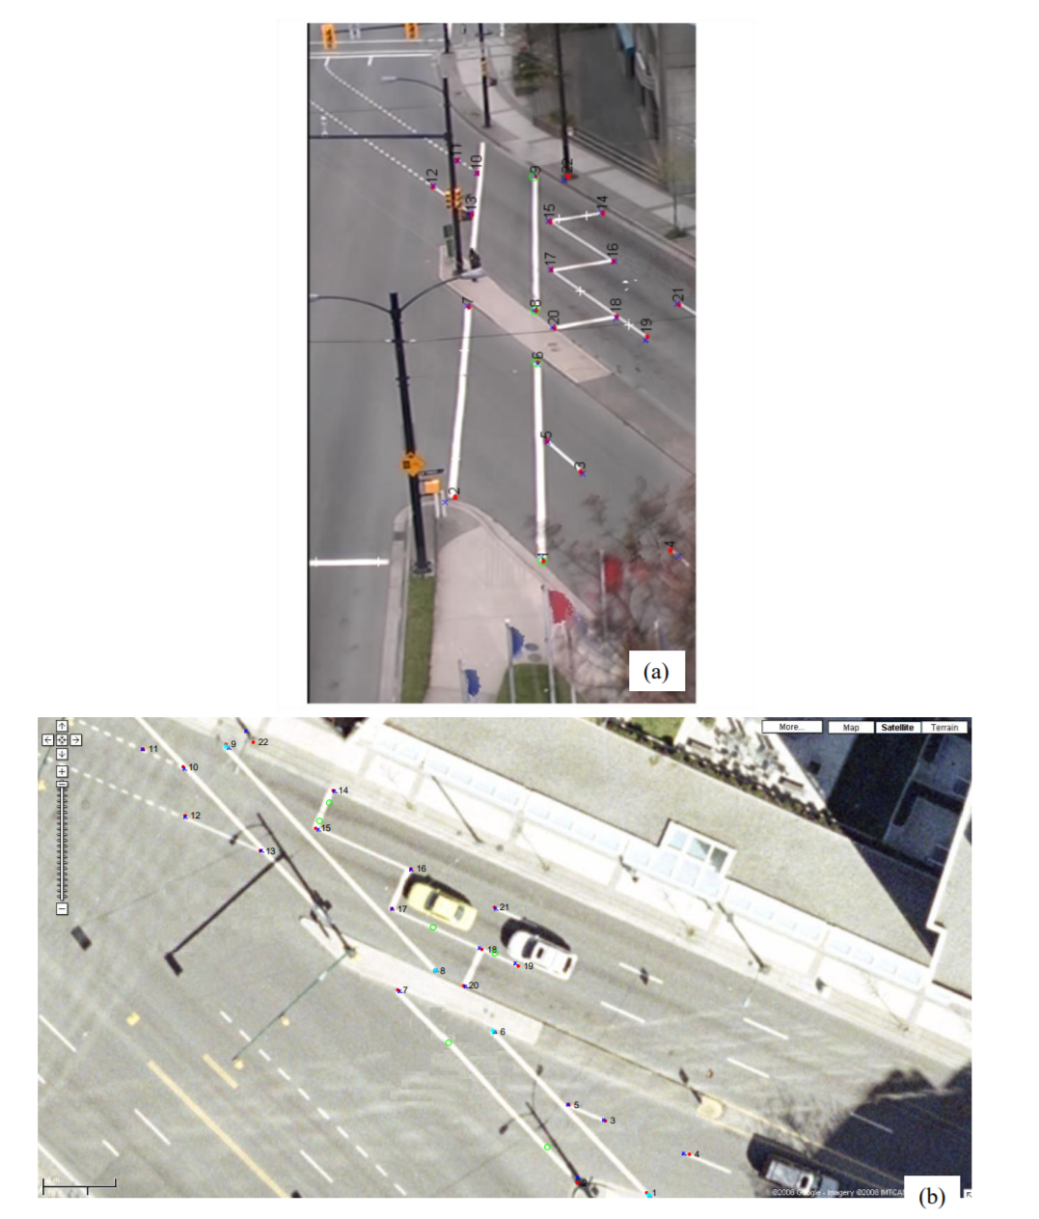
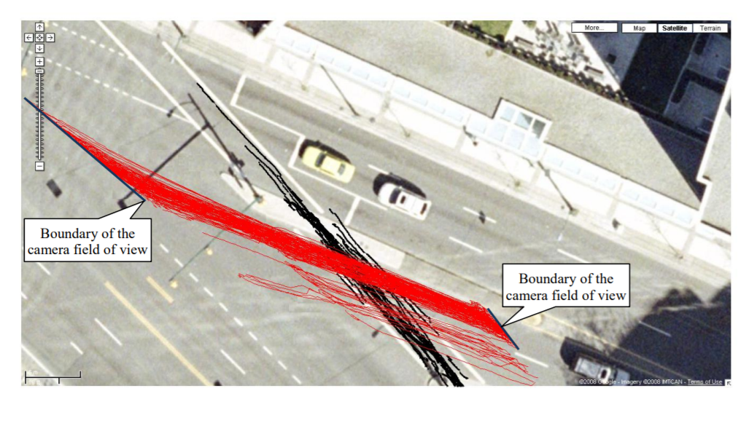
Video Processing
Automated Analysis of Pedestrian-Vehicle Conflicts Using Video Data. Ismail et al. (2009) https://doi.org/10.3141/2140-05

Slide 12
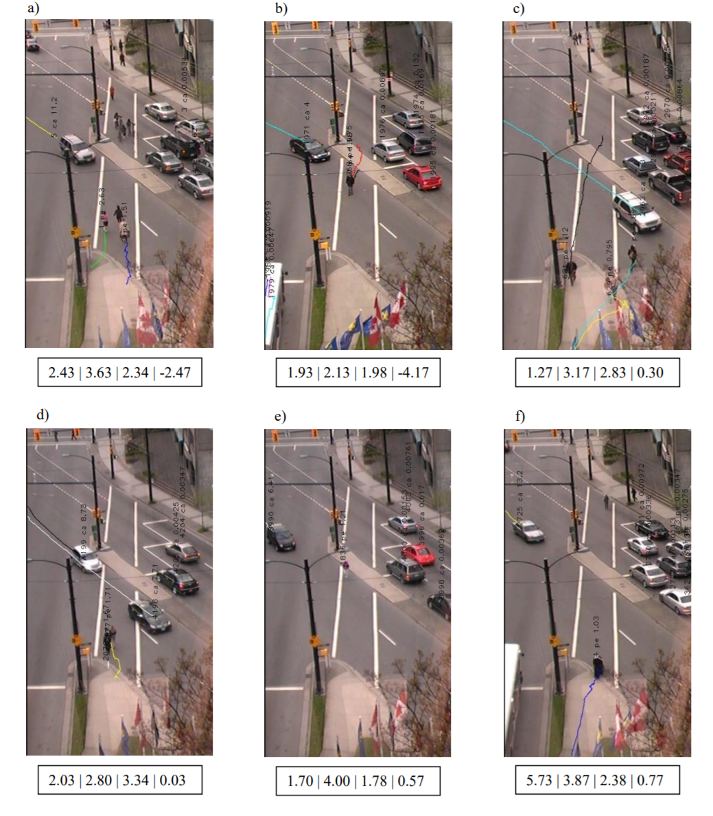
Video Processing
Automated Analysis of Pedestrian-Vehicle Conflicts Using Video Data. Ismail et al. (2009) https://doi.org/10.3141/2140-05

Slide 13
Data Users
Traffic Engineers: elimination of hazardous sites; highway design, etc.
Police force: enforcement location, etc.
Researchers: understanding the crash process; safety relationships, etc.
Decision-makers: alcohol measures, speed limit
Prosecutors: transportation-related criminal lawsuits, eye witness statements, etc.
Insurance companies: set premiums, types of vehicles, age of drivers,
Vehicle manufacturers: research for safer vehicles

Slide 14
Crash Report
Quality of data highly dependent on the officer at the scene of the crash
Most important data are collected for potential criminal prosecution; other data less important
Sometimes officers fill out the report on the scene while others do it at the end of the day (see next overheads)
Important to have an open line of communication between the engineering and police departments
Now, crash reports and process for collecting all electronic

Slide 15
Critical Information
Geographical location (intersections, mile-point, GIS)
Date (year, day of week, time of day, etc.)
Type of involvement (vehicle, driver, occupants, etc.)
Outcome (severity)
Environmental conditions (weather, lighting, road surface conditions)
Characteristics of collision (direction of road users, errors, collision type)

Slide 16
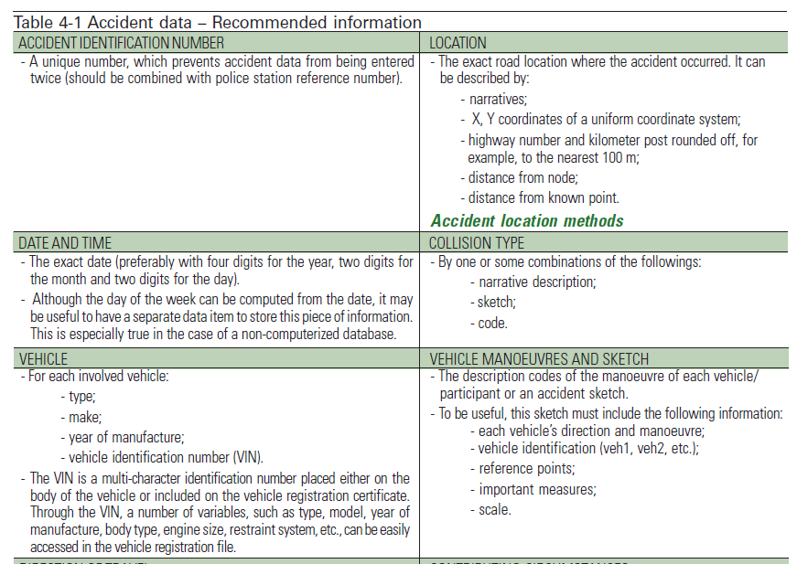
Critical Information
Taken from the 2003 version of the PIARC’s Road Safety Manual

Slide 17
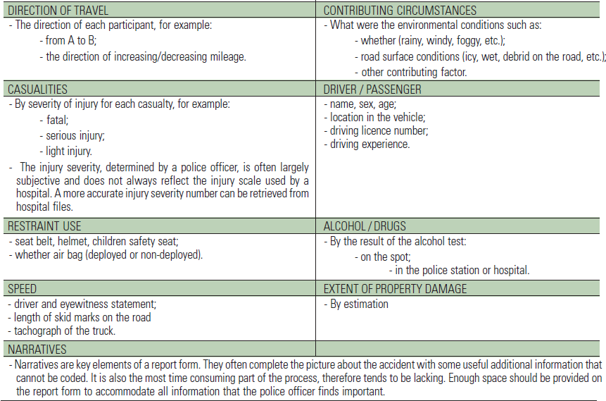
Critical Information
Taken from the 2003 version of the PIARC’s Road Safety Manual

Slide 18
Location Methods
Location of the crash is the most important aspect of data collection:
Estimate hazardous sites that experience more crashes than what would be expected
Provide a usually way to link different databases
Three methods: Link-Node, Route-Km Post (aka Control-Section), GPS coordinate

Slide 19
Link-Node
Nodes
Link

Slide 20
Route-Km Post
Every 200 m, there is small post on the side of the road
Highway 1
Distance 0
Highway 2

Slide 21
GPS System
Provides X and Y coordinates of a given geographical coordinate system
Advantages: human error free; many software tools include GPS coordinate; can estimate in the Z-coordinate (depth)
Disadvantages: Accuracy used to be an issue, but now the location pinpoint is very accurate (e.g., look at the location app on your smartphone).

Slide 22
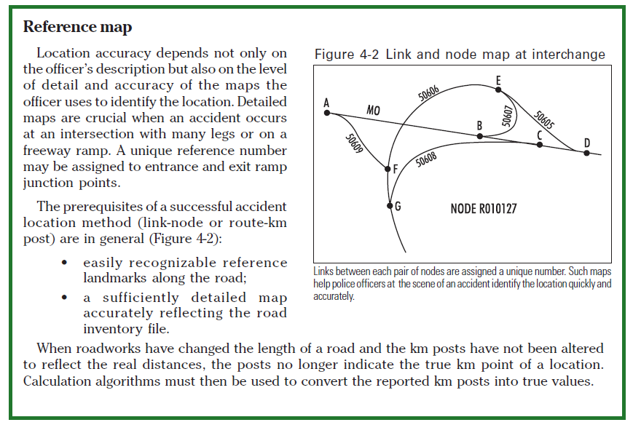
Road System Inventory
Taken from the 2003 version of the PIARC’s Road Safety Manual

Slide 23
Crash Data Storage
Old way: paper trails
All crashes are coded electronically (e.g., CRIS in Texas; FHWA’s HSIS)
Now, commercial programs available that displays visually simple crash statistics
Internet-based visual tools (using GIS/GPS capabilities: ARCView, etc.)
DBF, SAS, TXT files

Slide 24
Crash Data Limitations
Not all crashes are reportable
Personal injury (definition)
PDO (limit, changes over time)
Not all crashes are reported
Ignorance of the law
Victim’s unawareness of injury at the time of the collision
Desire to avoid bureaucracy
Desire to avoid insurance company penalties
Type of collision (single vehicle versus multivehicle)
Type of users (bicyclists and pedestrians)
Police force (report level varies by jurisdiction)
Reported crashes may contain errors
On report, fraudulent claims

Slide 25
Crash Data Limitations
Taken from the 2003 version of the PIARC’s Road Safety Manual

Slide 26
Crash Data Limitations
Taken from the 2003 version of the PIARC’s Road Safety Manual

Slide 27
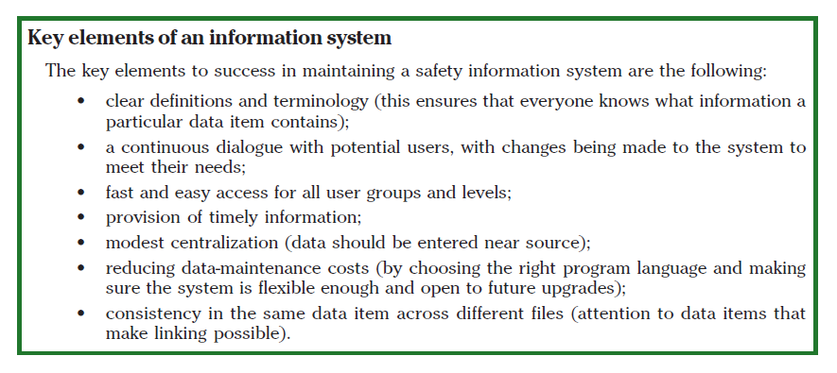
Integrated Data Files
Taken from the 2003 version of the PIARC’s Road Safety Manual

Slide 28
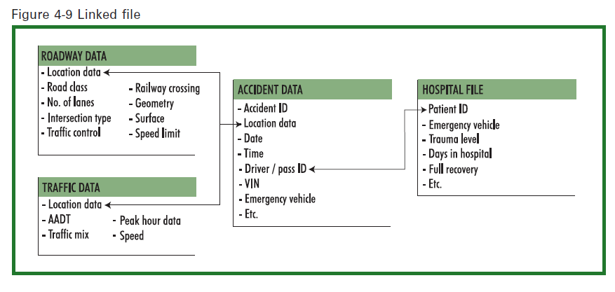
Integrated Data Files
Linking Files
Taken from the 2003 version of the PIARC’s Road Safety Manual

Slide 29
HSM Data Need
Crash Data — The data elements in a crash report describe the overall characteristics of the crash. While the specifics and level of detail of this data vary from state to state, in general, the most basic crash data consist of crash location; date and time; crash severity; collision type; and basic information about the roadway, vehicles, and people involved.
Facility Data — The roadway or intersection inventory data provide information about the physical characteristics of the crash site. The most basic roadway inventory data typically include roadway classification, number of lanes, length, and presence of medians, and shoulder width. Intersection inventories typically include road names, area type, and traffic control and lane configurations.

Slide 30
HSM Data Need
Traffic Volume Data — In most cases, the traffic volume data required for the methods in the HSM are annual average daily traffic (AADT). Some organizations may use ADT (average daily traffic) as precise data may not be available to determine AADT. If AADT data are unavailable, ADT can be used to estimate AADT. Other data that may be used for crash analysis includes intersection total entering vehicles (TEV), and vehicle- miles traveled (VMT) on a roadway segment, which is a measure of segment length and traffic volume. In some cases, additional volume data, such as pedestrian crossing counts or turning movement volumes, may be necessary.
Research Results Digest 329
HIGHWAY SAFETY MANUAL DATA NEEDS GUIDE (June 2008)
http://onlinepubs.trb.org/onlinepubs/nchrp/nchrp_rrd_329.pdf

Slide 31
HSM Data Need
Limitations of observed crash data include:
• Data quality and accuracy
Data entry—typographic errors;
Imprecise entry—the use of general terms to describe a location;
Incorrect entry —entry of road names, road surface, level of crash severity, vehicle types, impact description, etc.;
Incorrect training—lack of training in use of collision codes;
Subjectivity—Where data collection relies on the subjective opinion of an individual, inconsistency is likely. For example, estimation of property damage thresholds or excessive speed for conditions may vary.
• Crash reporting thresholds and the frequency-severity indeterminacy
• Differences in data collection methods and definitions used by jurisdictions

Slide 32
Naturalistic Data (SHRP2)

Slide 33
What is SHRP 2
The central goal of SHRP 2 Safety research is to address the role of driver performance and behavior in traffic safety. This includes developing an understanding of how the driver interacts with and adapts to the vehicle, traffic environment, roadway characteristics, traffic control devices, and the environment. It also includes assessing the changes in collision risk associated with each of these factors and interactions. This information will support the development of new and improved countermeasures with greater effectiveness.

Slide 34
Objectives of SHRP 2
SHRP 2 has four focus areas: Capacity, Reliability, Renewal, and Safety. The Safety focus area is conducting the NDS. It will allow us to record and study the driving behaviors of a large sample of drivers in their personal vehicles.
http://www.trb.org/StrategicHighwayResearchProgram2SHRP2/PublicationsSHRP2.aspx
http://www.shrp2nds.us/
http://www.ctre.iastate.edu/shrp2-s04a/

Slide 35
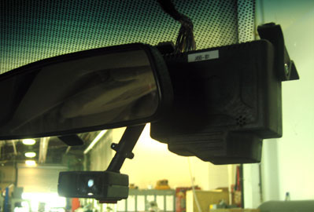
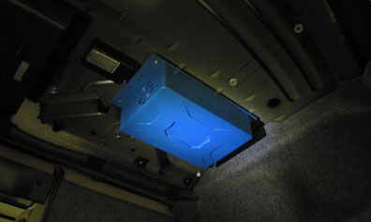
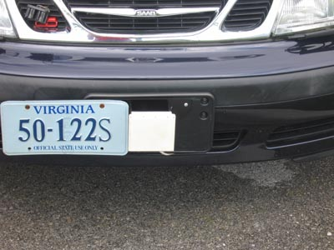
Equipment
The installed instrumentation or data acquisition system will collect data using a number of sensors and video cameras whenever the vehicle is running. The data acquisition system (DAS) that will be used for this study will compile data from the vehicle network as well as from sensors added for this particular study.
Head Unit
Main Unit
Radar

Slide 36
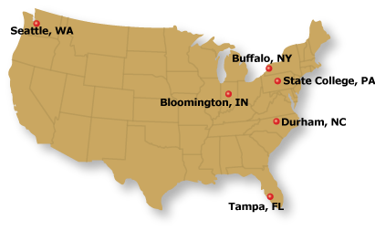
Locations

Slide 37
Products of SHRP 2
The resulting data, expected to exceed 1 petabyte in size—about the size of a million 1-gigabyte USB flash drives—will provide a wealth of information regarding driving behavior, lane departures, and intersection activities, which are anticipated to be of interest to transportation safety researchers and others for at least 20 years.
All future research efforts that seek to use the data collected in the SHRP 2 NDS will require institutional review board (IRB) approval.
In addition, researchers must establish a data-sharing agreement that guarantees privacy.

Slide 38
Studies produced from SHRP 2
http://www.trb.org/StrategicHighwayResearchProgram2SHRP2/Pages/The-SHRP-2-Naturalistic-Driving-Study-472.aspx#publications
100-Car study:
https://www.nhtsa.gov/sites/nhtsa.dot.gov/files/100carmain.pdf
Strategic Highway Research Program (SHRP2): https://insight.shrp2nds.us/ (https://vtnews.vt.edu/articles/2015/05/050115-vtti-datasharingproject.html)

Slide 39
Sources of Data - Traditional
Highway Safety Information System: http://www.hsisinfo.org/
Fatality Analysis Reporting System: https://www-fars.nhtsa.dot.gov/Main/index.aspx
National Automotive Sampling System: https://www.nhtsa.gov/national-automotive-sampling-system-nass/nass-general-estimates-system
General Estimates System: http://www.nhtsa.gov/NASS
Crashworthiness Data System: https://www.nhtsa.gov/national-automotive-sampling-system/crashworthiness-data-system
Crash Outcome Evaluation System: https://www.nhtsa.gov/crash-data-systems/crash-outcome-data-evaluation-system-codes
Model Minimum Uniform Crash Criteria: http://www.mmucc.us/
Bureau of Transportation Statistics: https://www.bts.gov/content/motor-vehicle-safety-data
Each State Agency should have data available.
Local cities or counties may have data available.

Slide 40
Sources of Data – ND/DTD
UDRIVE (Europe): https://results.udrive.eu/
UMTRI (Michigan): http://www.umtri.umich.edu/our-focus/naturalistic-driving-data
Australian Naturalistic Study: http://www.ands.unsw.edu.au/
Streetlight Data: https://www.streetlightdata.com/ (exposure)
Safe2save Data: https://safe2save.org/ (exposure)

