Slide 1
Crash Contributing Factors and Traffic Injury Costs
Fall 2023

Slide 2
Important Resources
Evans, L. (2004) Traffic Safety. Science Serving Society. Bloomfield Hills, MI (see also Evans, L. (1991) Traffic Safety and the Driver. Van Nostrand Reinhold. New York, N.Y.)
Smiley, A. (editor) (2015) Human Factors in Traffic Safety. 3rd edition, Lawyers & Judges Publishing Company, Inc., Tucson, AZ. (see also Dewar, R.E., and P.L. Olson. (2007) Human Factors in Traffic Safety. 2nd edition, Lawyers & Judges Publishing Company, Inc., Tucson, AZ.)
Shinar, D. (2017) Traffic Safety and Human Behavior. 2nd edition. Emerald Group Publishing Limited, Bingley, UK. (see also Shinar, D. (2007) Traffic Safety and Human Behavior. Emerald Group Publishing Limited, Bingley, UK.)

Slide 3
Human-Environment-Vehicle System
Provide a conceptual framework to analyze motor vehicle collisions.
Example: A 20-year old man with little driving experience, is taking an unfamiliar road on his way to an interview. His vehicle is not properly maintained. In fact, the tires are in poor shape. At some point on the trip, the rain starts to fall. Shortly thereafter he enters a horizontal curve with a radius below minimum standards, loses control of the vehicle and run off the road into a tree located within a few feet of the traveled way.
Question: What are the contributing factors that have lead to this crash?

Slide 4
Human-Environment-Vehicle System
System Component | Event | Circumstance
Human | Trip | Young, inexperienced, stressed
Vehicle | Choice of vehicle | Tires in poor condition
Environment | Rain | Wet and slippery surface
Environment | Curve | Below standard
Human | Steering maneuver | Oversteering
Human | Loss of control | Unstabilized shoulder
Environment | Roadside conditions | Tree too close traveled way
Outcome | Impact (crash)

Slide 5
Crash Contributing Factors

Slide 6
Crash Contributing Factors
http://cyberlaw.stanford.edu/blog/2013/12/human-error-cause-vehicle-crashes
https://www.fhwa.dot.gov/publications/publicroads/95winter/p95wi14.cfm

Slide 7
Crash Contributing Factors
Paper under review (as of July 2023) by Dong and Wood: Evaluating Crash Contributing Factors https://engrxiv.org/preprint/view/2942/5423

Slide 8
Haddon Matrix
 | Agent | Host | Physical Environment | Social Environment
Pre-event
During the event
Post-event
William H. Haddon, Jr., came up with a Matrix to systematically analyze car crashes in a 1972 paper.

Slide 9
Using the Haddon Matrix

Slide 10
System Elements: The Road User
Myth: “accident prone” individuals
Safe and successful operation is influenced by factors: physical, psychological and cognitive.
“Spare mental capacity”
Human errors: rule based, knowledge base, and skill based
Drivers capable of adapting to driving situations: strategic, tactical and operational

Slide 11
System Elements: The Vehicle
Design of the vehicle: seats, easy ingress and egress, essential controls within reach
Vehicle is dynamic device (must be in accordance to driver expectancy)
Uniformity in operation of controls and displays (not always uniform from one vehicle to the next)

Slide 12
System Elements: The Road
Uniformity for highway design and traffic control devices
Provide proper navigational information
System still not fully adequate
Research still on-going for understanding the relationship between road design (geometric, control devices, etc.) and safety. Some relationships are better understood than others.

Slide 13
Perception and Information Processing

Slide 14
Perception
Stimulus applied to any sense organs
For motor vehicles: visual is the most important (also smell, auditory, tactile)
Some important elements for driving task: color, contrast sensitivity, eye movement depth perception, static visual acuity, etc.

Slide 15
Fields of View
Peripheral vision
Eye
60º Visual Cone
10º Detection

Slide 16
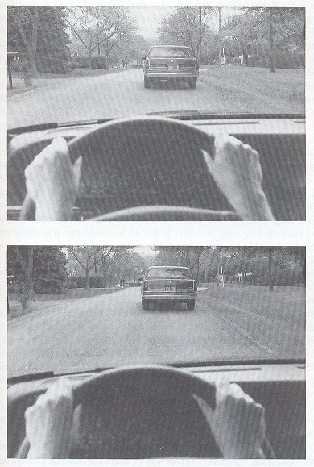
Judgment of Spacing

Slide 17
Stages of Perception-Response Time
Detection
Identification
Decision
Response

Slide 18
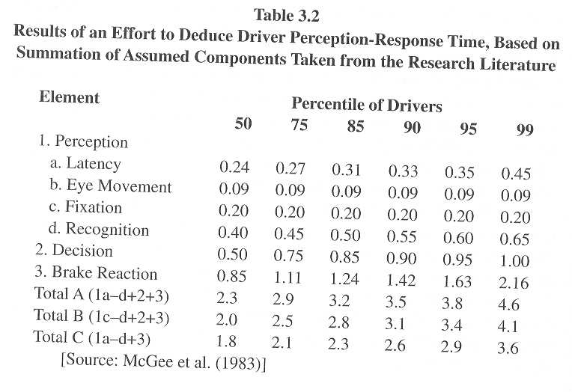
Deduced Perception-Response Time

Slide 19
Factors Affecting PRT
Detection
  Object conspicuity
  Amount of information being processed by the driver
Identification
  Poor visibility: nighttime and fog
  Speed and trajectory of the potential hazard

Slide 20
Factors Affecting PRT
Decision
  Choice: steering, braking (& accelerating?)
  Choice may sometimes be more complex
Response
  Usually minor component of PRT
  Time allocated for foot leaving the accelerator and hitting the brake pedal

Slide 21
Factors Affecting PRT
Driver Expectancy
  Predisposition on the part of drivers that something will happen or be configured in a certain way
  Violation of expectancy will lead to longer PRT
Night versus Day
  Many situations have the same PRT (see next figure)
  Detection may play a role in the difference

Slide 22
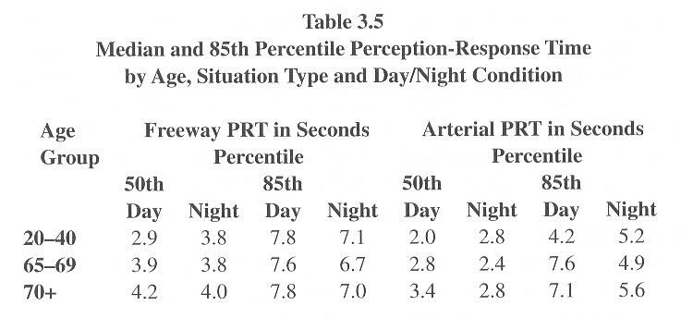
Night versus Day PRT

Slide 23
Factors Affecting PRT
Driver Fatigue
  Difficult to measure, but increase in driver fatigue will increase PRT
Age and Gender
  PRT increases with age (0.44 sec for 20 years to 0.52 for 70 years of age)
  Female drivers have longer PRT than male drivers

Slide 24
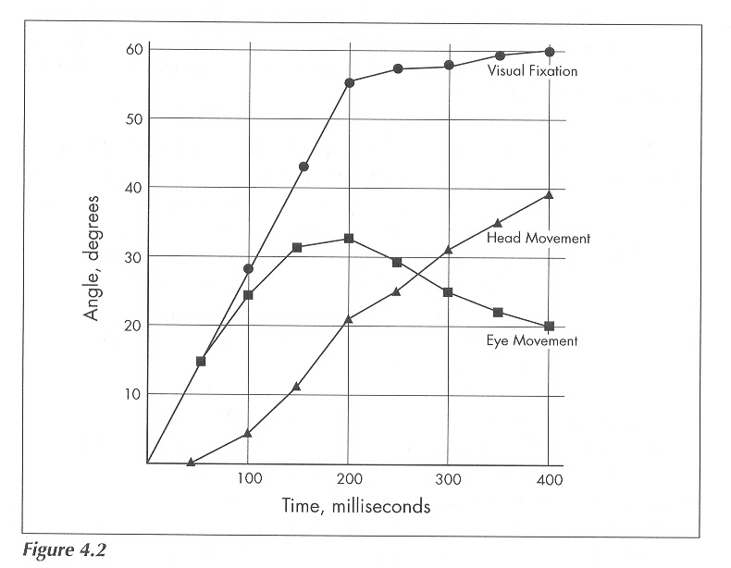
Looking Behavior
Changing Lanes at Intersections

Slide 25
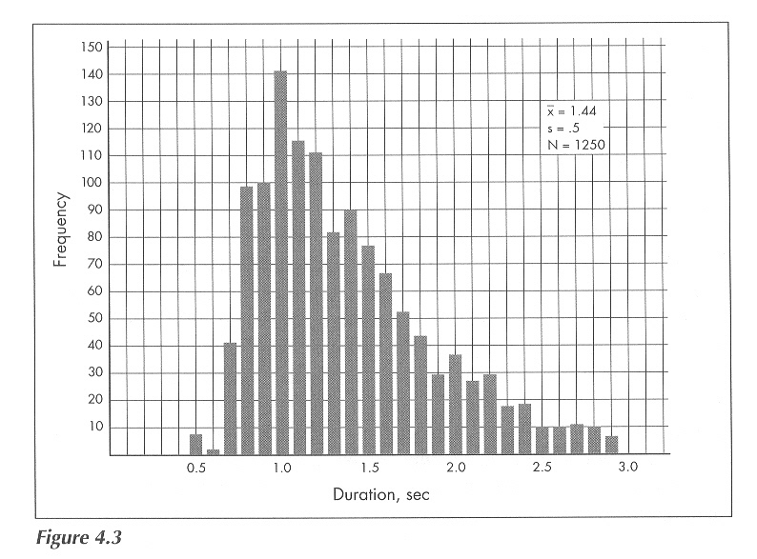
Eye Fixation for Car Radios

Slide 26
Driver Performance

Slide 27
Acquisition of Driving Skills
Cognitive Phase
Associative Phase
Autonomous Phase

Slide 28
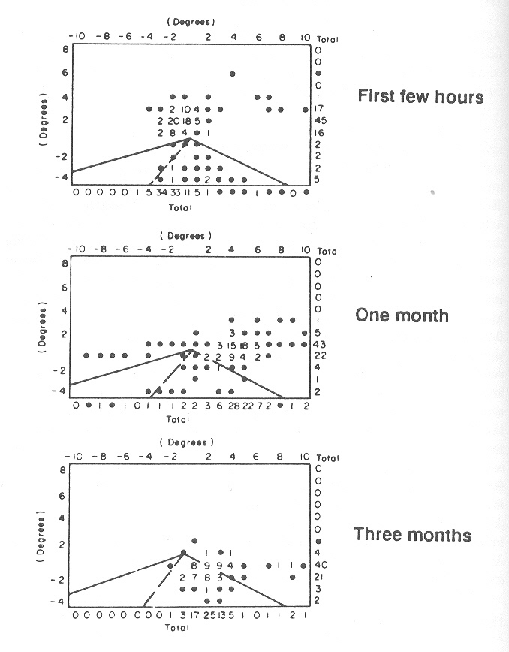
Eye Fixations of Novice Drivers

Slide 29
Individual Differences
Personality
  Relationship between personality and crashes is weak (i.e., personality changes with time, confounding variables)
  Some personality trait causing fatigue may lead to higher risk of crashes
Emotions
  Emotional disturbances affect all aspect of our life, including driving
  Higher heart rate and blood pressure associated with increase traffic flow

Slide 30
Individual Differences
Stress
  Stress can be caused by emotional (e.g., divorce), cognitive (e.g., cut-off), and physiological (e.g., sick).
  Leads to aggression, confusion and risky behavior
Motivation
  Car ownership important to people
  Motivational elements: travel for necessity, social status, freedom, self-expression
  Faulty motivation may lead to higher risk behavior
  Marketing of motor vehicles

Slide 31
Individual Differences
Risk Taking Behavior
  Objective versus subjective risk
  Sensation seeking (SS) individuals: relationship not established SS and risky driving
  Risk homeostasis theory
Social Factors
  Drivers are influenced by other drivers “culture of driving”
  Drivers are also influenced by passengers (family members versus teenagers)

Slide 32
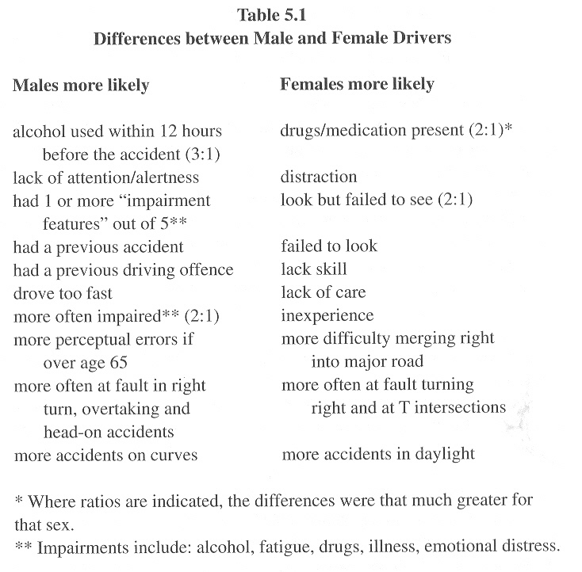
Male and Female Drivers

Slide 33
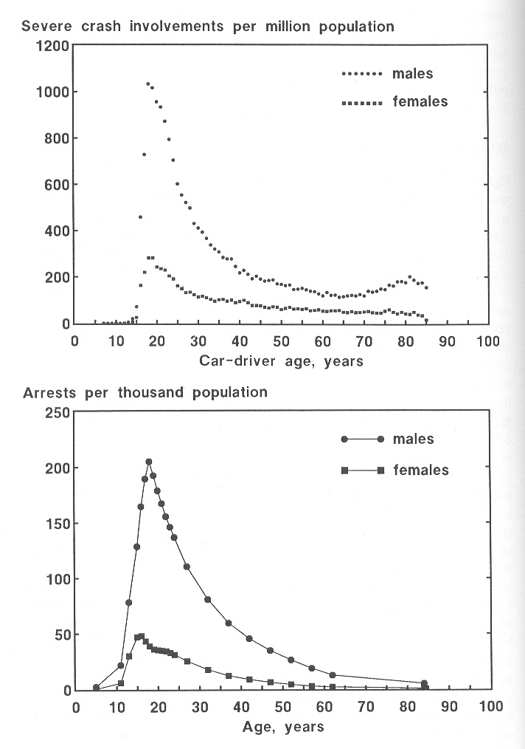
Male and Female Drivers

Slide 34
Valuation of Transportation Safety
Value of Life
Human Capital
Willingness to Pay
+
Collective Decision
Direct Costs
Changes in Individual Risk
Output Losses
Net Consumption
Court Awards
Government Decisions
Gross Output
Wage Differentials
Pain & Suffering
Consumer Behavior
Hypothetical Risk Reduction

Slide 35
Human Capital
Medical Costs
Emergency Services
Property Damage
Administrative expenses
Issues:
  Large uncertainty
  Some costs would have been used even if collision has not happened

Slide 36
Human Capital
Net of Consumption
  Excess of expected output over their expected consumption during the remaining lifetime
  In other words, it is to the benefits passed to future generations
Gross Output
  The victim’s total output (victim’s own loss)
Issues:
  Negative excess output
  Children and older people are less valued
  Uncertainty about future earnings and discount rate

Slide 37
Pain & Suffering
Emotional losses caused by motor vehicle crashes (mental & physical)
So far, only measured by courts
Issues:
  Difficult to measure
  When death occurs, the burden of the emotional loss is beard by the family
  Court awards in the US include a punishment in addition to pain & suffering

Slide 38
Willingness to Pay
Based on the premise that people are better judge of their own welfare
Known as “Compensation Variation”
Characteristics:
  Collective Risk or Decision
    Wage differentials, Government decisions, etc.
  Changes in Individual Risk
    buying behavior, questionnaires, etc.
  Value of Statistical Life: aggregating values of entire population and dividing it by the number of deaths avoided

Slide 39
Summary
All methods have problems
Subjective versus perceived risk (crashes are extreme events)
The wide variety in value of life has a significant impact on safety investments and interventions
What are the alternatives?

Slide 40
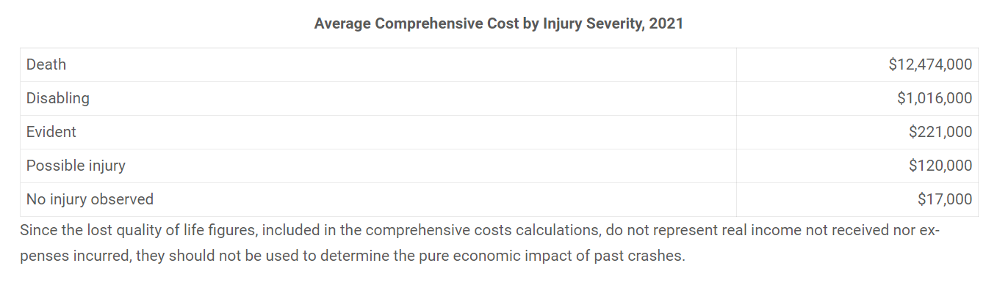
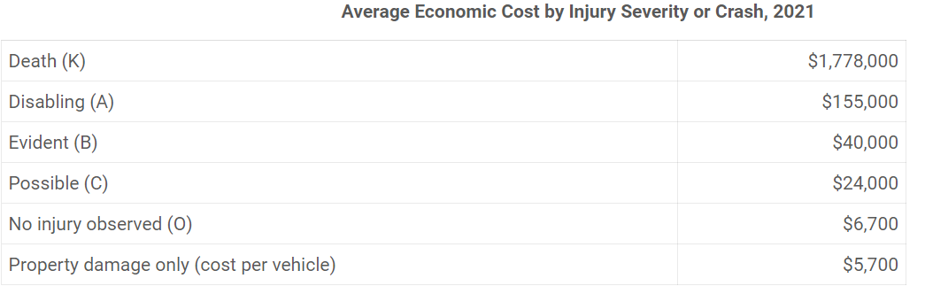
Values Used for Highway Safety Analyses
Comprehensive Crash Costs (per person)
https://injuryfacts.nsc.org/all-injuries/costs/guide-to-calculating-costs/data-details/
Average Crash Costs (per person)

