Slide 1
CVEN 626 HIGHWAY SAFETY
Instructor: Dominique Lord
Room 301B (DLEB)
Phone: (979) 458-3949
d-lord@tamu.edu
Fall 2023

Slide 2
TEXTBOOK
Required Textbook
Lord, D., X. Qin, S.R. Geedipally (2021) Highway Safety Analytics and Modeling. 1st Ed., Elsevier Publishing Co., Amsterdam, NL.
Highly Recommended Text:
Road Safety Fundamentals: Concepts, Strategies, and Practices that Reduce Fatalities and Injuries on the Road. (2017) FHWA-SA-18-003, Federal Highway Administration, Washington D.C. (https://rspcb.safety.fhwa.dot.gov/rsf/docs/Road_Safety_Fundamentals.pdf)
Road Safety Manual (2019&2015) World Road Association (https://roadsafety.piarc.org/en) (free download after registration)
Road Safety Manual (2003) World Road Association. You can find the CD version of the manual at the library. Please install the CD-ROM on your computer.
Other Recommended Textbooks:
AASHTO (2010) Highway Safety Manual. 1st Ed. American Association of State Highway and Transportation Officials. Washington, D.C.
Hauer, E. (1997) Observational Before-After Studies in Road Safety: Estimating the Effect of Highway and Traffic Engineering Measures on Road Safety. Elsevier Science Ltd, Oxford.
Hilbe, J.M. (2011) Negative Binomial Regression. 2nd Ed. Cambridge University Press, Cambridge, UK.

Slide 3
TEXTBOOK
Other relevant material:
WHO (2015) Global status report on road safety. World Health Organization, Geneva. (http://www.who.int/violence_injury_prevention/road_safety_status/2015/en/)
Hauer, E., (2015) The art of regression modeling in road safety. Springer, USA.
Cameron, A.C., and P.K. Trivedi (2013) Regression Analysis of Count Data. 2nd Ed., Cambridge University Press, Cambridge, U.K.
Elvik, R. and T. Vaa (2009) Handbook of Traffic Safety Countermeasures. Elsevier Science. 2nd Ed., Amsterdam, The Netherlands.
WHO (2004) World Report on Road Traffic Injury Prevention. Eds. Peden et al. World Health Organization, Geneva. (https://www.who.int/violence_injury_prevention/publications/road_traffic/world_report/en/)

Slide 4
ACCESS TO MATERIAL
Canvas

Slide 5
GRADING
Assignments: 40% (6-8)
Term Paper: 40% (due Dec. 5th, 2023; presentation on Dec. 1st)
Class Participation: 20%
Grading Scheme:
A = 90% and above, B = 80 to 89%, C = 70 to 79%, D = 60 to 69%, F = below 60%

Slide 6
TOPICS COVERED
Introduction: Traffic Safety Definition and Global Impacts of Traffic-Related Injuries (1 lecture)
Human Factors in Traffic Safety (1 lecture)
Economic Costs of Crashes and Value of Life (1 lecture)
Crash Data Collection and Database Management (1 lecture)
Elements of Statistics and Crash Count Distributions (1 lecture)
Exploratory Analysis of Crash Data (1 lecture)
Regression Analysis of Count Data and Development of Statistical Models (3 lectures)
Before-After Studies (2 lectures)
Network Screening and Diagnosis (Identification of Hazardous Sites) (1 lecture)
Study Design (1 lecture)
Crash Modification Factors & HSM (Only if time permits)

Slide 7
What is safety?
Fall 2023

Slide 8
Highway Safety
Significant global issue both in terms of morbidity and economic losses (discussed in greater details next week).
Main goal consists of reducing the number and severity associated with crashes (vehicles, pedestrians and bicyclists). (Civil engineers focus on the design and operation of highways and its effects on safety)
Was not a hot topic (research wise) until the early to mid-90s. (Few researchers)
Now, a lot of funding, research and application of methods are devoted to highway safety. (Lots of researchers)
Vision-Zero/Safe Systems

Slide 9
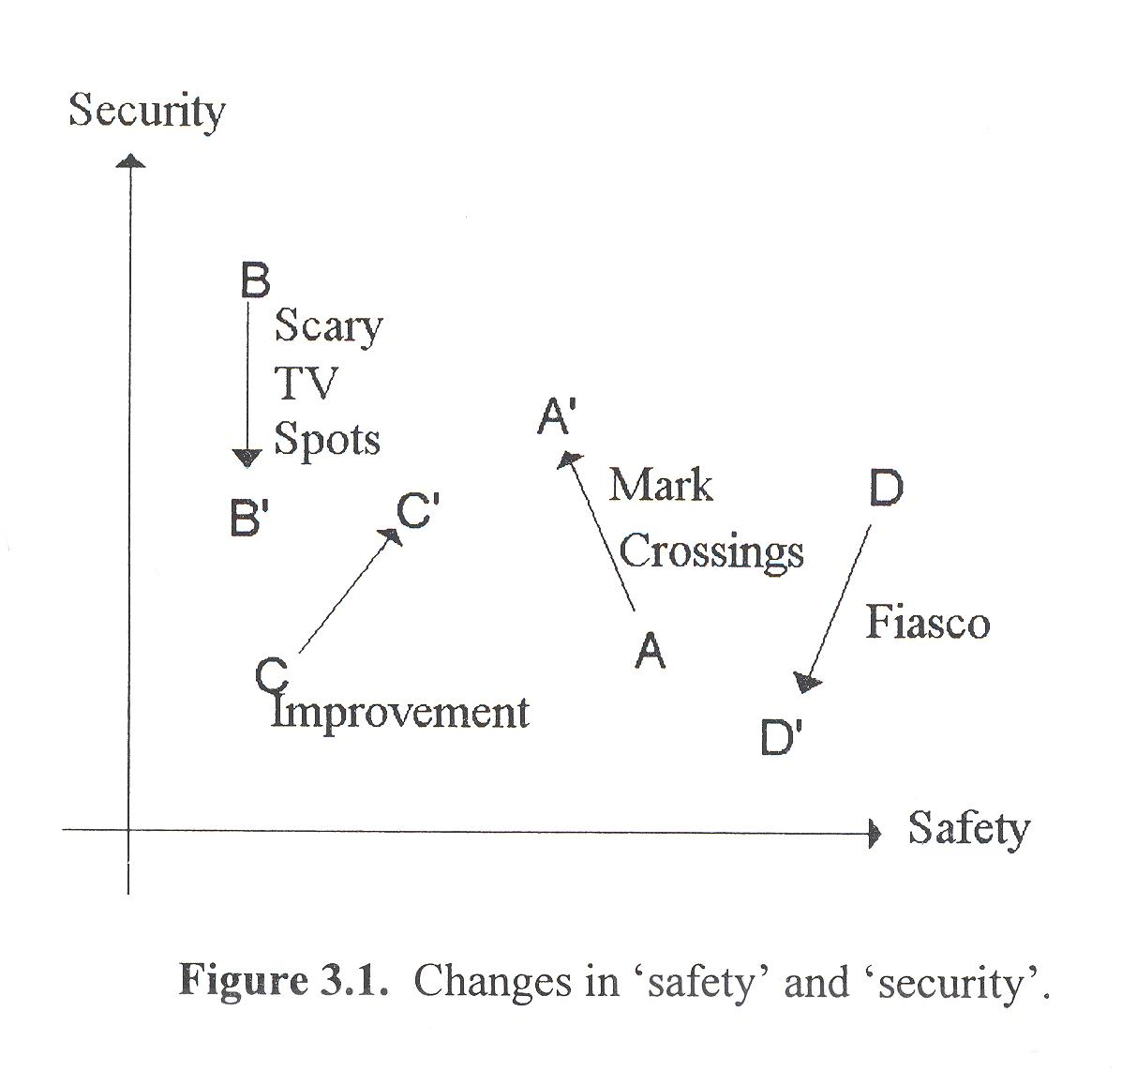

Slide 10
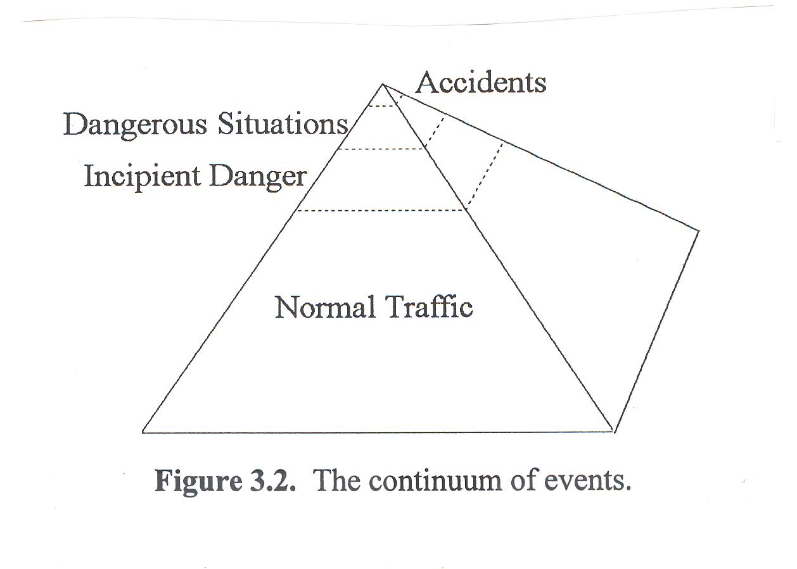

Slide 11
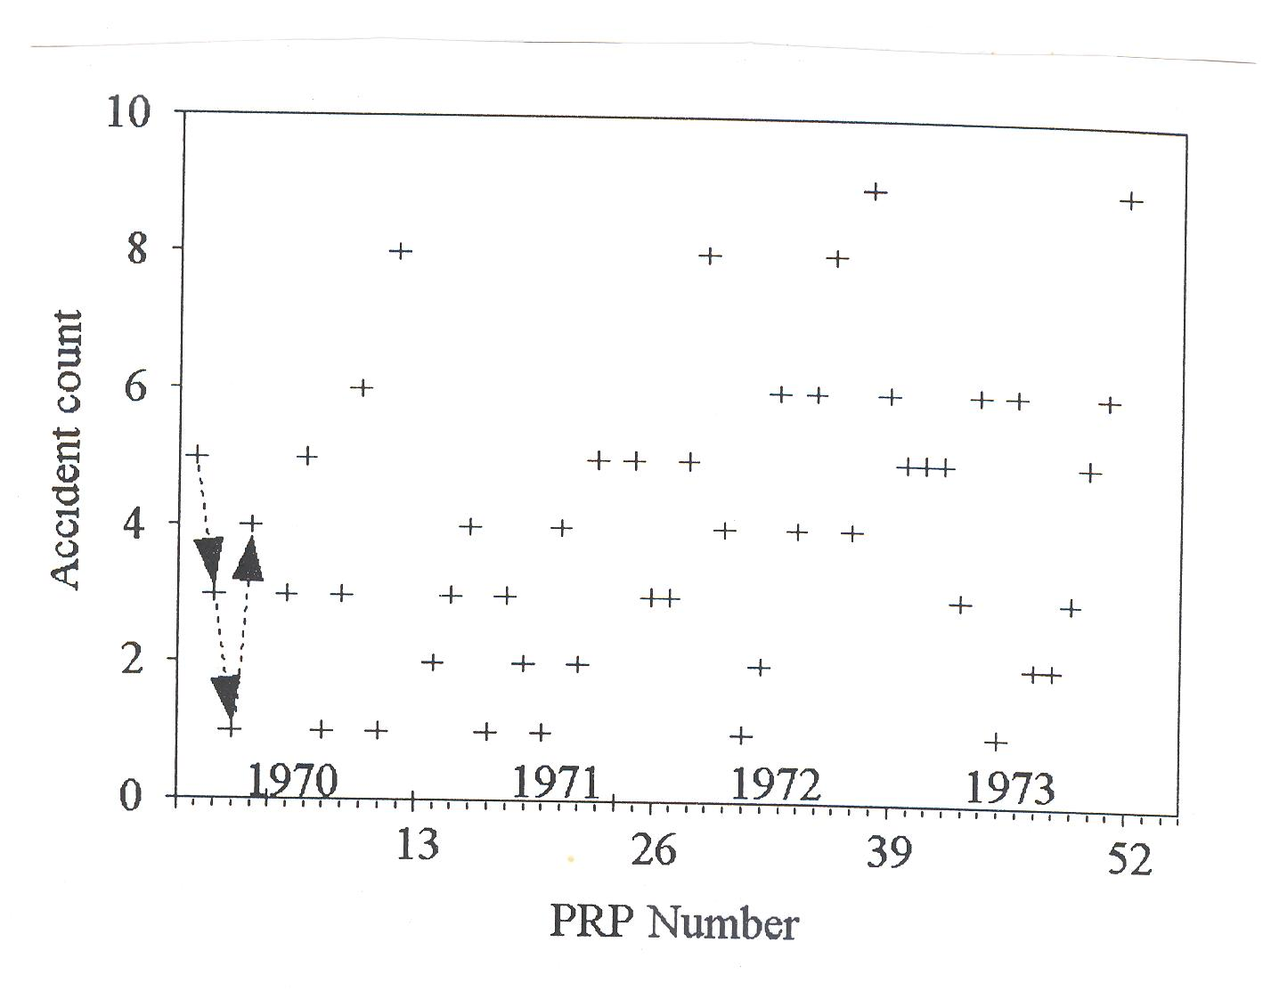

Slide 12
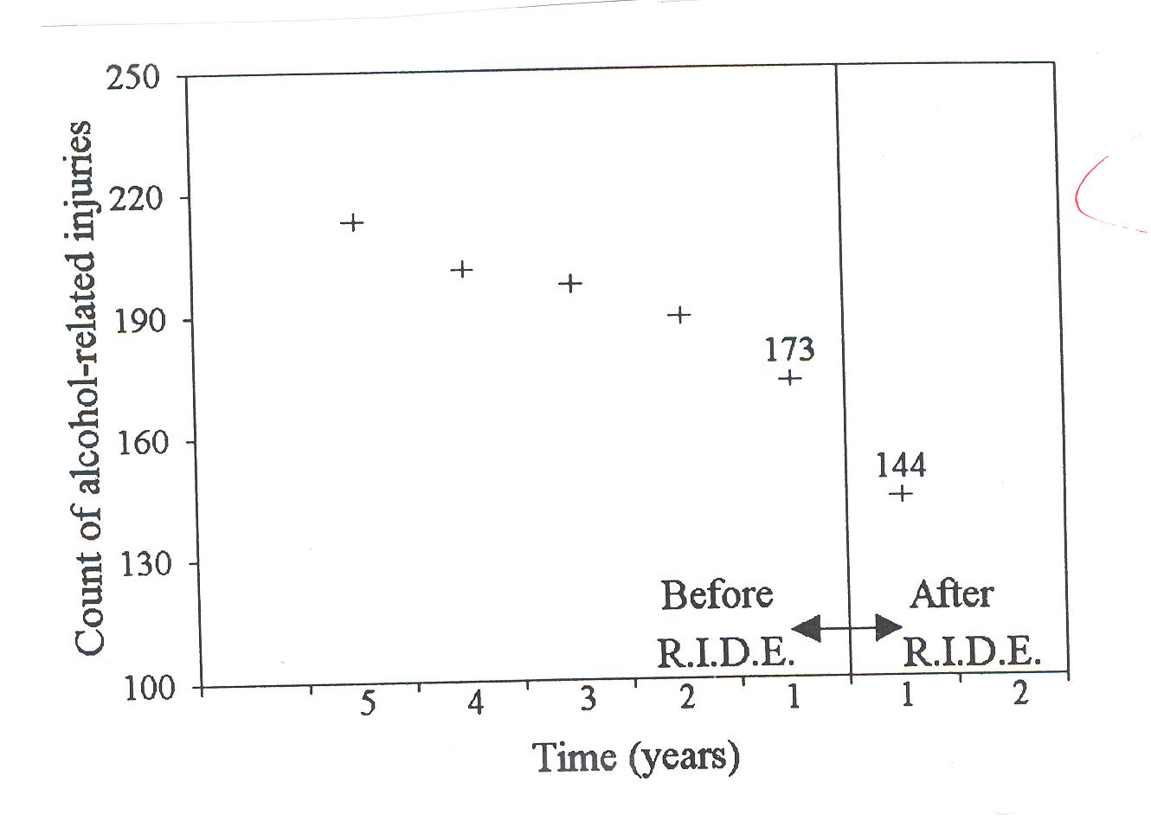

Slide 13
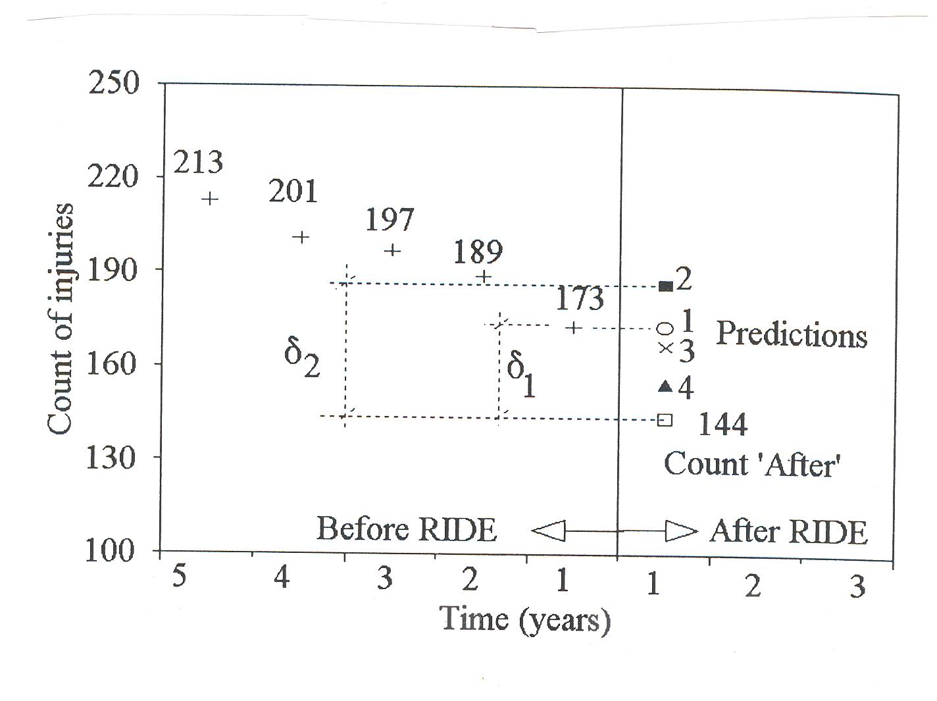

Slide 14
Definition
For the purpose of this course, the relevant definition is to examine the number of crashes per unit of time by severity level.
The goal is to estimate how the design and traffic operation of different elements of the highway network affect the number and severity of crashes. For us, it is from the perspective of civil engineering.
Note that highway safety involves multiple fields, such as law enforcement, psychology/human factors, mechanical, industrial and electrical engineering, economics, sociology, medicine and policy makers among others. It is a multidisciplinary discipline. Specific for this course:
Making sense of crash and other safety data
Examine the relationship between design/operational variables and crash risk
Understanding crash causation factors
Estimating risk of injury when a crash occur
Estimating the safety effects of treatments
Economic impacts of safety decisions

